Slide 1
Introduction to Public Health
Module # 10
Introduction to Noncommunicable Diseases and obesity.
DR. SHAIKH ABDUS SALAM
Dept. of Public Health
North south University

Slide 2
OBJECTIVES OF THE LECTURE
By the end of this lecture you will be able to:
Conceptualize
  The over nutrition
  the impacts of obesity.
  Obesity & its causes and prevention
Understand the concept of NCDs & various steps that can be taken to measure the obesity such as BMI or QI etc.
Dr. Shaikh Abdus Salam
1

Slide 3
Noncommunicable Disease(life style disease)
NCD: Diseases one cannot catch from another person.
Or Diseases that do not transfer.
1. Life style changes
2. Environment change
3.Allergy
4.Side effects of Medicine, drugs etc.
5. Nutrient deficiency
6. Prolong illness
7. Heredity/ genetic
Dr. Shaikh Abdus Salam

Slide 4
Obesity
An abnormal growth of adipose tissue due to an enlargement of fat cell size ( Hypertropic) or an increase fat cell number( Hyperplastic) or a combination of both
Major risk factors for a number of chronic diseases, including diabetes, cardiovascular diseases and cancer
Once considered a problem only in high income countries, now dramatically on the rise in LMIC, particularly in urban settings

Slide 5
Causes of obesity
Genetic factor
Age
Sex
Socioeconomic factor
Physical inactivity
Eating habit
Family tendency
Endocrine factor
Drugs ,alcohol
Education
Ethnicity
Dr. Shaikh Abdus Salam

Slide 6
How to measure obesity and overweight
Skinfold thickness
Waist circumference
WHR
Broca’s index
BMI or QI
Measuring fat cell
Dr. Shaikh Abdus Salam

Slide 7
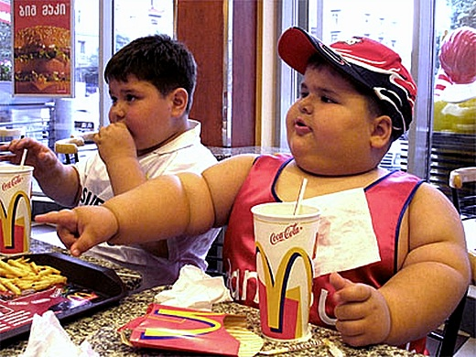
Obesity
Anorexia nervosa
Bulimia nervosa

Slide 8
Preventing obesity
Follow a healthy eating plan- balance of energy IN and energy OUT
Focus on portion size
Be active- walk, bike or physical exercise
Reduce screen time- use of TVs, computers, DVDs, and videogames because they limit time for physical activity
Keep track of your weight, body mass index, and waist circumference

Slide 9
Calculate Your Body Mass Index (BMI)
A common method of evaluating your weight
BMI= body weight (in Kg)/height (m)²

Slide 10
BMI Intervals
Under weight
Normal weight
Overweight
Obese
Less than 18.5
18.5-24.9
25-29.9
30 and above

Slide 11
RDA#Recommonded Dietery Allowence
Carbohydrate = 50% - 65%
Protein = 15%-20%
Fat = 25%-30%
Dietary Fiber = 25 -40 gram/ day Approx.
Fresh vegetables+ fresh Fruits = Plenty if calorie free or zero kcal.
Table salt = Less than 5 gm/day
Water = for one kcal one ml of water plus daily loss.
Dr. Shaikh Abdus Salam

Slide 12
Complications of Obesity
Clinical and Medical
Mechanical
Psychological
Dr. Shaikh Abdus Salam

Slide 13
Management of obesity
Health education
Diet control
Exercise
Treatment
Lifestyle changes/ Changes of attitude and behaviour
Dr. Shaikh Abdus Salam

Slide 14
Noncommunicable Disease(life style disease)
Distribution by person involves the study of CVD in relation to:
Individual attributes: age, sex ,occupation
Personal habits: smoking, drinking ,sedentary living
Predisposing states: obesity, stress,DM
Dr. Shaikh Abdus Salam

